Slide 1

Club Kickoff Meeting
September 4, 2019

Slide 2
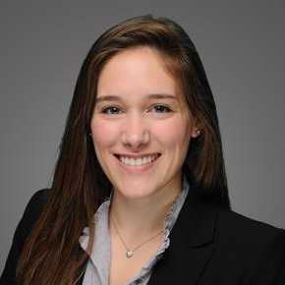
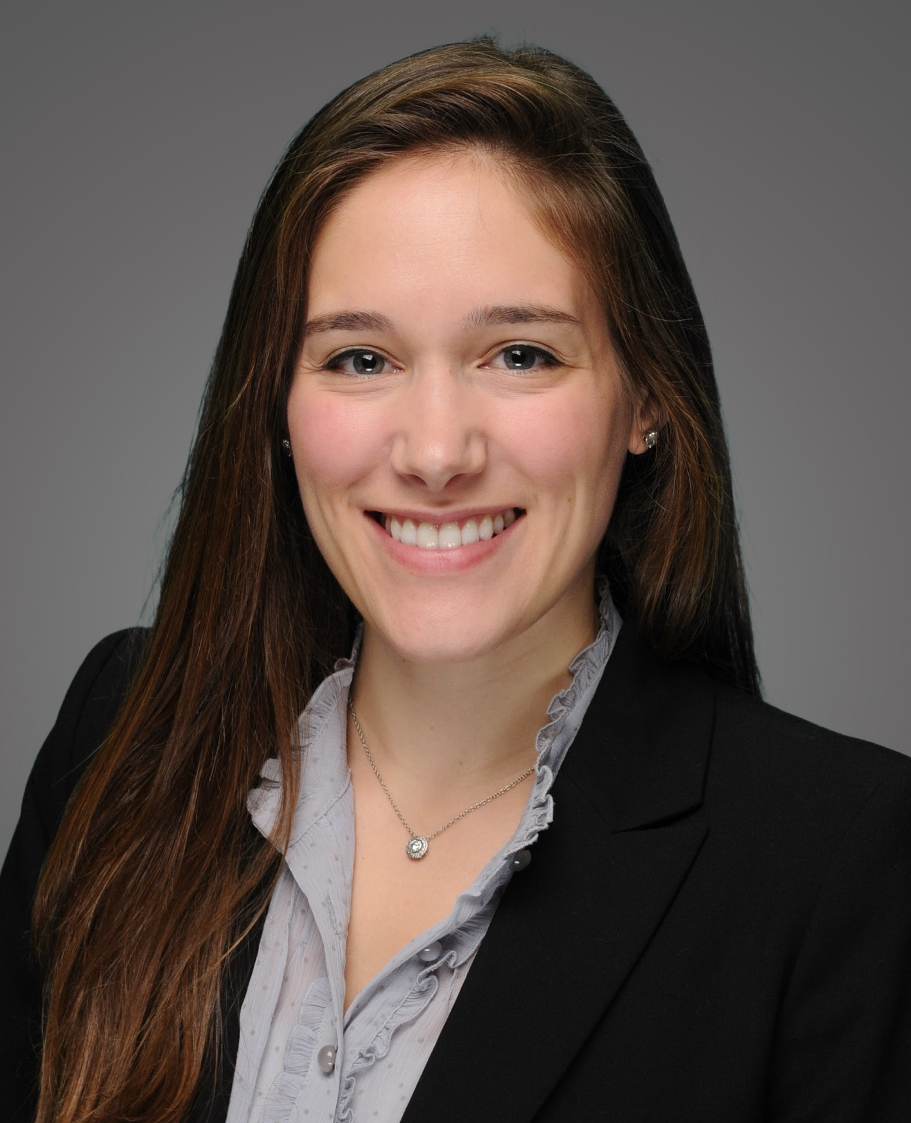
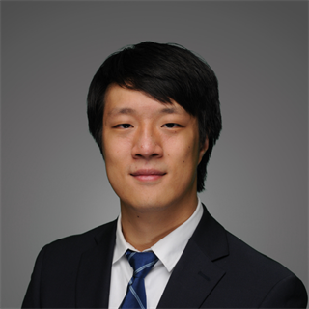
Co-Presidents
Alice Schnurman
Alice.Schnurman@stern.nyu.edu
Undergrad: University of Pennsylvania
Pre-Stern: Management Consulting
Summer Internship: JPMorgan Chase Management Associate Program
Other Interests: Finding the best cupcake in NYC
Jake Han
Jake.Han@stern.nyu.edu
Undergrad: Boston University
Pre-Stern: State Street
Summer Internship: Citi Finance Management Associate Program
Other Interests: Cooking, Video Games

Slide 3
Agenda
Welcome
Club Overview
Meet the Board
AVP Applications
Happy Hour Details

Slide 4
Club Overview

Slide 5
Our Mission
The Stern Management & Strategy Club (SMS) provides information, awareness, networking opportunities and career development for students interested in careers in corporate finance, general management, internal strategy, rotational, and leadership development programs across a variety of industries.
Notes:
What differentiates us from MCA and GFA
You get what you want out of it, it’s okay to be recruiting for other things or not know what you want to do

Slide 6
Benefits of Joining
Career Preparation
Interview questions database
Interview prep sessions and MBA2 office hours
Informative panels
  What is Corporate Finance?
  What is a Rotational Program?
  Recruiting Real Talk
Company- Specific Information
Lunch & Learns with Amex, Deloitte, JPMorgan, PepsiCo, Pfizer, etc.
Database of roles related to general management, corporate finance, human capital, internal strategy, and rotational programs
Networking and Exposure
One of the largest alumni networks of any Stern club
SMS Resume Book submitted to recruiters
Access to the Board, MBA2 SMS members, Langone members, and alumni

Slide 7














Corporate Relationships
*Above list is not exhaustive*

Slide 8
SMS Recruiting at Stern
*Above list is not exhaustive*
Amazon: Finance Leadership Development Program
American Express: Corporate Finance; Enterprise Strategy & Execution
Anheuser-Busch InBev: Global MBA Program
Citi: Finance Management Associate Program
Deloitte: Internal Strategy
Estee Lauder: Presidential Associate Program
JetBlue: Internal Strategy
Liberty Mutual: Corporate Development Program
L’Oreal: Management Development Program
Marsh & McLennan: Finance Leadership Development Program
MasterCard: Management Rotational Program
PepsiCo: Strategic Finance
Pfizer: Corporate Finance; Internal Strategy & Consulting
Prudential: Rotational Program

Slide 9
Meet the Board

Slide 10
Organization Chart
Co-Presidents
Knowledge Management (KM) &
Corporate Finance (CF)
Corporate Relations
Compile interview prep materials for general management and corporate finance tracks
Host workshops for behavioral and technical interview prep
Manage external sponsorships
Plan and execute Lunch & Learns
Serve as an on-campus liaison for firms
Events
Alumni Relations
Langone
Plan social events for club members (e.g., happy hour, dinner)
Plan alumni happy hours and coordinate alumni spotlight
Coordinate scheduling for Langone events
Admissions
Communications
Finance
Interface with incoming students
Distribute weekly newsletter
Manage SMS budget
Approve club expenditures

Slide 11
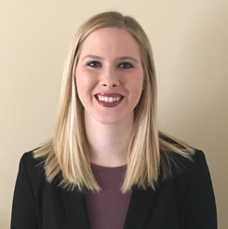
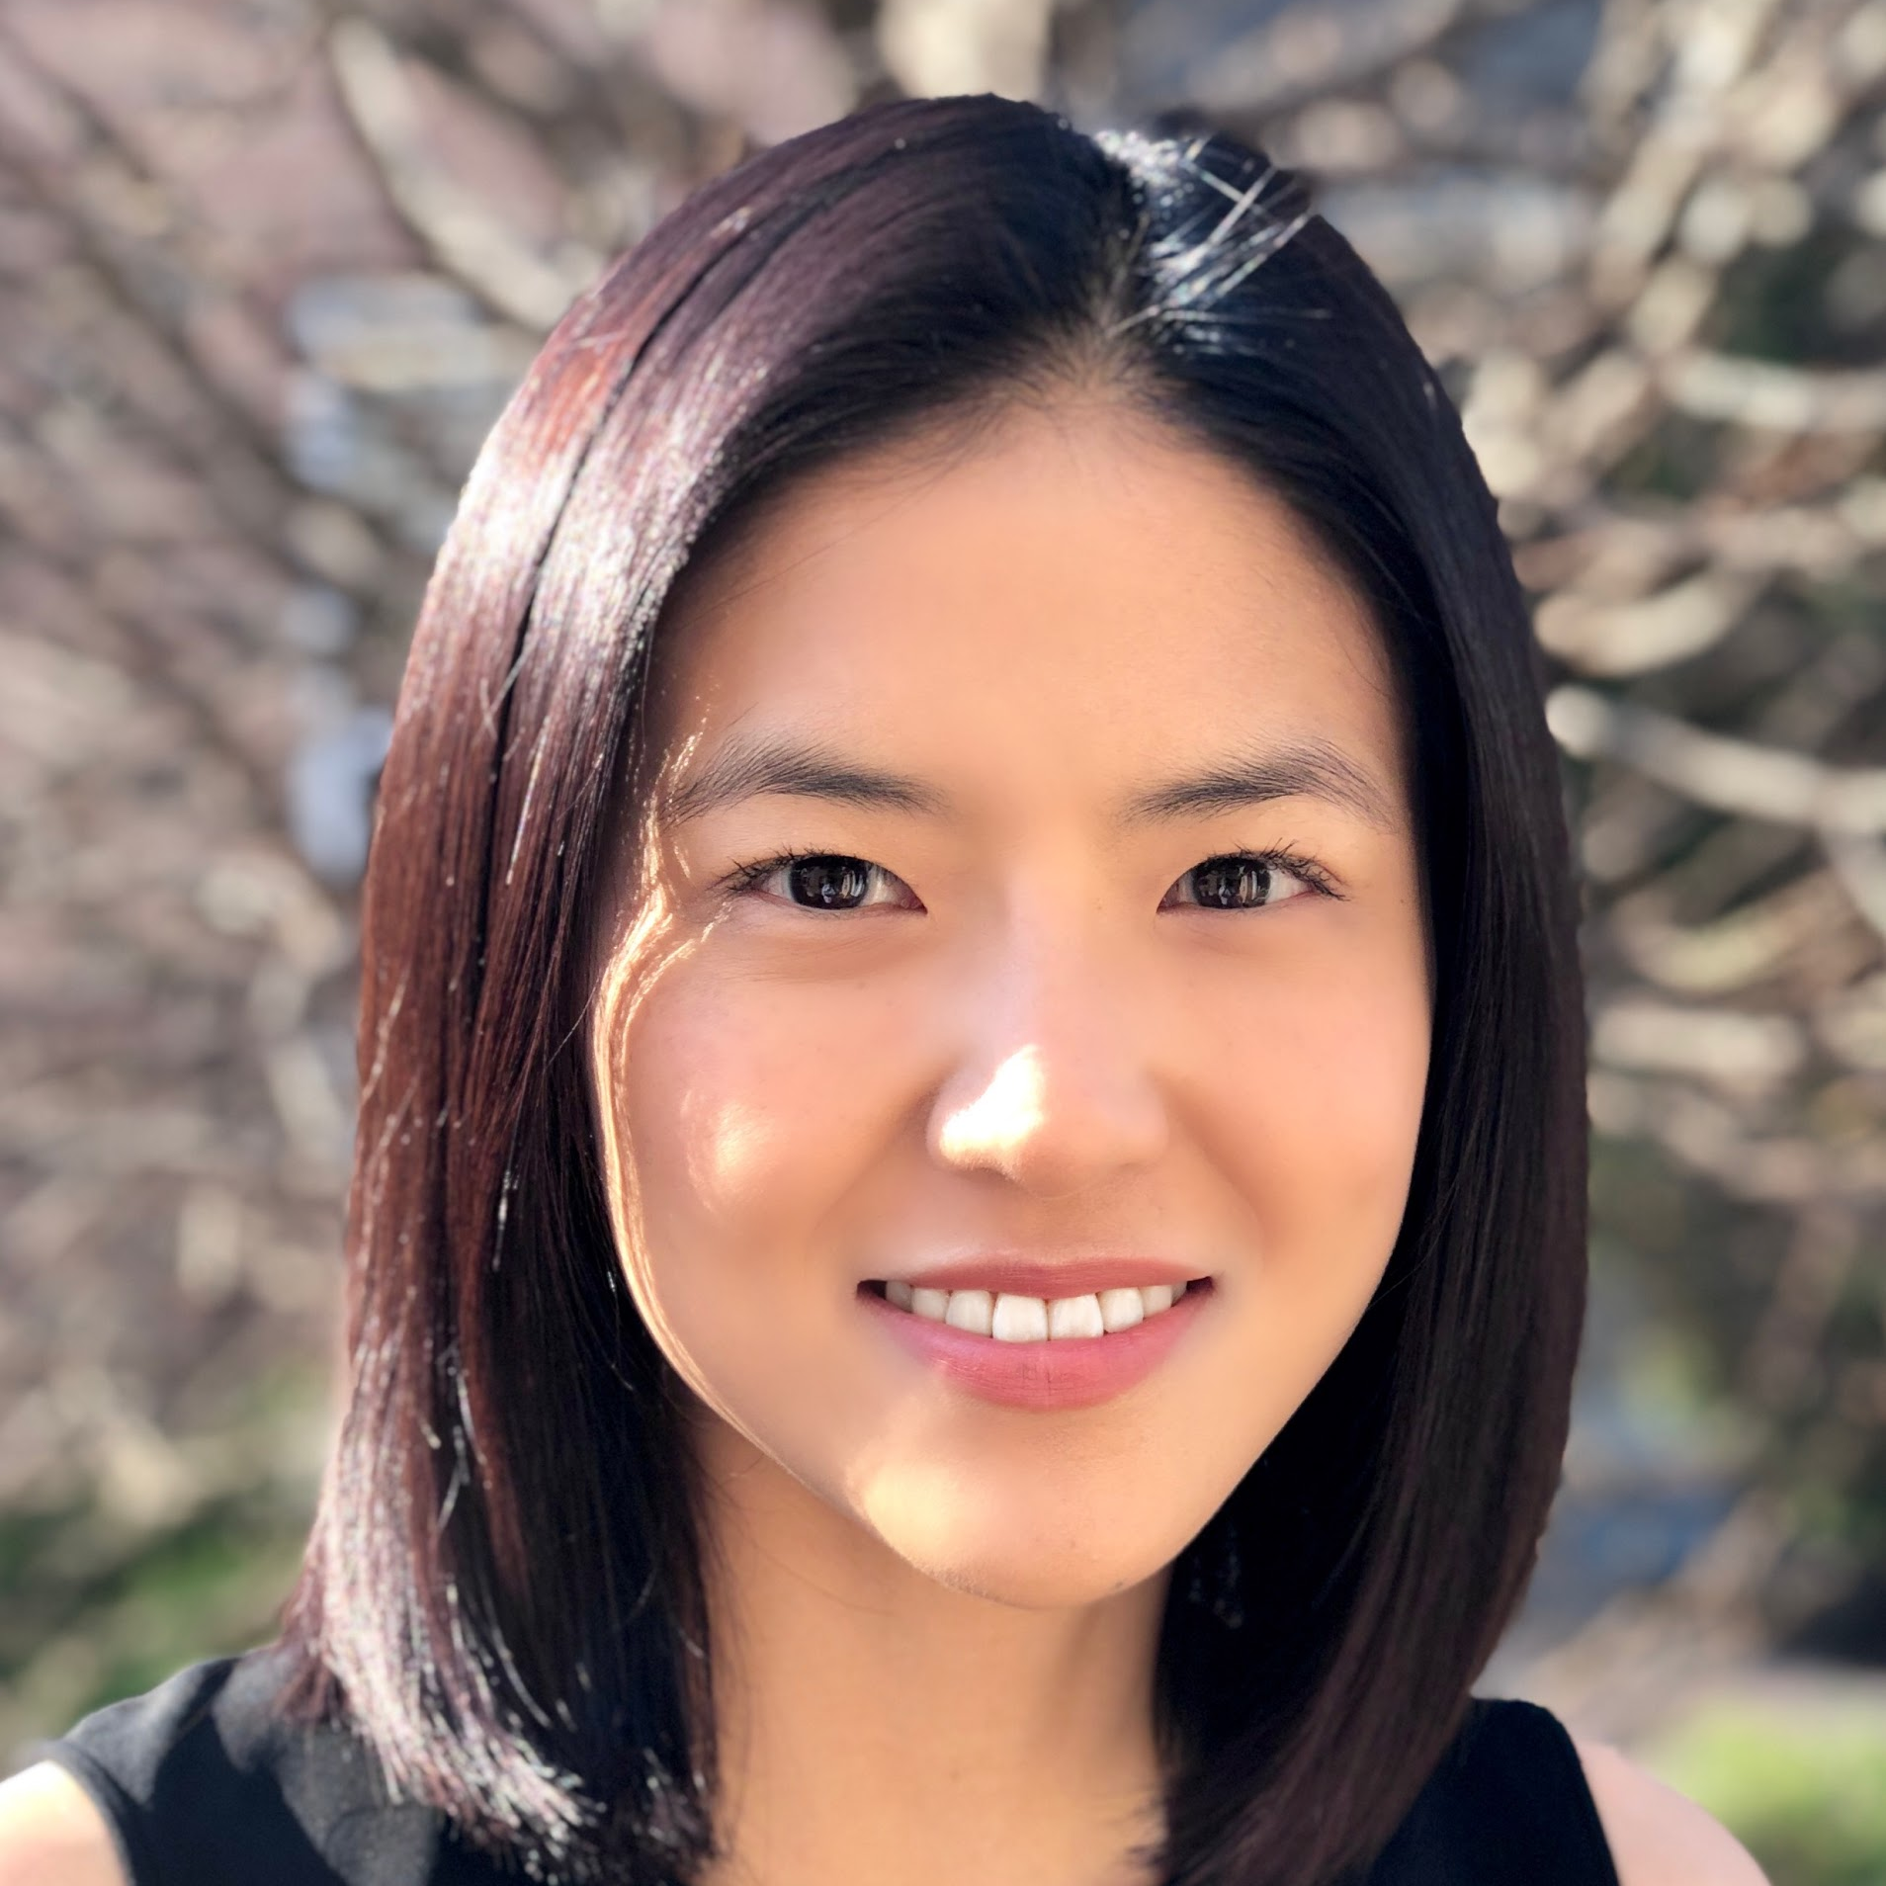
Corporate Relations
Kelly Kennedy
Kelly.Kennedy@stern.nyu.edu
Undergrad: Purdue University
Pre-Stern: Salesforce
Summer Internship: Marsh & McLennan Companies Finance Leadership Development Program
Other Interests: Ballroom Dancing
Jennifer Lee
jl2858@stern.nyu.edu
Undergrad: Wellesley College
Pre-Stern: Corporate Finance and Treasury
Summer Internship: Strategy&
Other Interests: Cooking (breakfast food like Croque Monsieurs as well as Thai curries), Occasionally exercising (weightlifting/plyometrics)

Slide 12
AVP of Corporate Relations (2)
Key liaison with corporate partners to share key dates, information and deliverables related to their sponsorship level
Promote club to prospective company partners, leveraging both new relationships as well as stewarding sponsors from previous years
Work with MBA2 VPs and OCD to facilitate recruiting and networking events
Assist in sourcing sponsorships and maintain communication/relationship with company
Responsible for the following deliverables: sponsorship package, and target companies for sponsorship

Slide 13
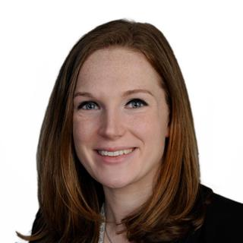
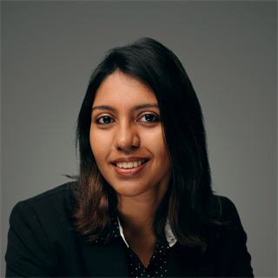
Knowledge Management
Molly Joyce
Molly.Joyce@stern.nyu.edu
Undergrad: University of Michigan
Pre-Stern: Moody’s Investors Service
Summer Internship: Pricewaterhouse Coopers
Other Interests: Running, Cooking, Knitting
Tanya Sharma
Tanya.Sharma@stern.nyu.edu
Undergrad: National Institute of Technology, Rourkela
Pre-Stern: Tata IQ (Business Analytics)
Summer Internship: The DB Method
Other Interests: Reading, Travelling

Slide 14
AVP of Knowledge Management (2)
Design and launch series of events highlighting on-campus and off-campus recruiting opportunities and resources
Develop materials for interview prep day(s) in January
Collaborate within club, and with other clubs to co-sponsor panels and events
Opportunity to set best practices for career prep and other knowledge related events for the club going forward

Slide 15
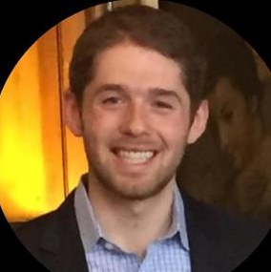
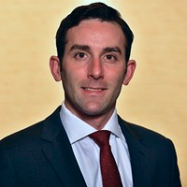
Corporate Finance
Benjamin Gottesdiener
Benjamin.Gottesdiener@stern.nyu.edu
Undergrad: WashU in St. Louis
Pre-Stern: Bank of America Merrill Lynch (Equity Research)
Summer Internship: JPMorgan Chase Management Associate Program
Other Interests: Hiking, Running, Soccer (Everton!)
Matthew Kahn
Matthew.Kahn@stern.nyu.edu
Undergrad: Bentley University
Pre-Stern: Deloitte
Summer Internship: Marsh & McLennan Companies Finance Leadership Development Program
Other Interests: Skateboarding, Rock Climbing

Slide 16
AVP of Corporate
Finance (2)
Design and launch series of events highlighting on-campus and off-campus recruiting opportunities and resources
Develop materials for interview prep day(s) in January
Collaborate within CSF, and with other clubs to co-sponsor panels and events related to corporate finance
Opportunity to set best practices for career prep and other knowledge related events for the Corporate Finance vertical going forward

Slide 17
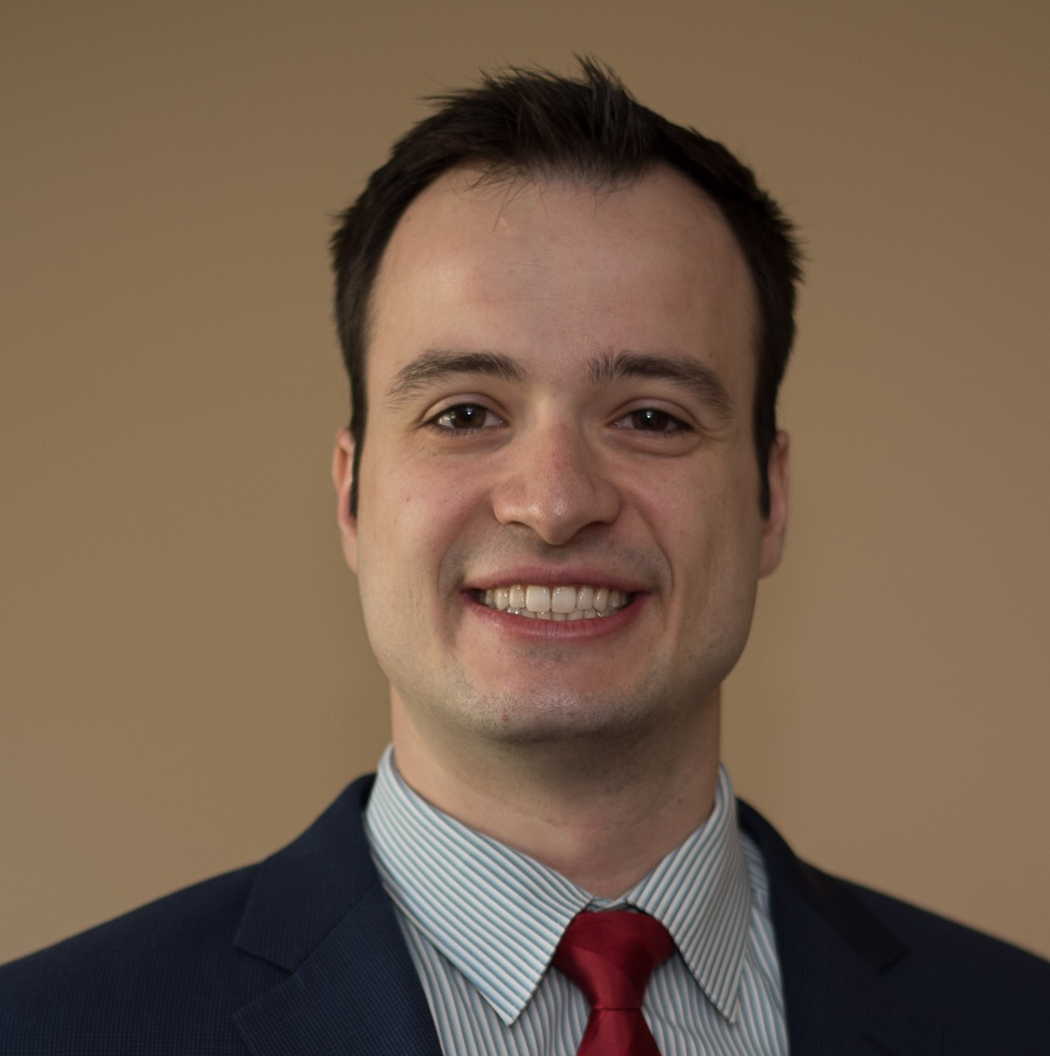
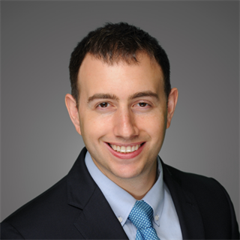
Events
Ryan Barbaccia
Ryan.Barbaccia@stern.nyu.edu
Undergrad: Penn State University
Pre-Stern: Ford Motor Company
Summer Internship: BCG
Other Interests: Coffee, Fitness, Craft Beer
Samuel Knopf
Samuel.Knopf@stern.nyu.edu
Undergrad: Washington University in Saint Louis
Pre-Stern: Accenture
Summer Internship: Deloitte Internal Strategy
Other Interests: Ice Hockey, Cycling

Slide 18
AVP of Events (2)
Plan and host SMS events such as:
    Social Events/Happy Hours/Beer Blast
    Plant tours
    Logistics for Corporate Events
    Source and invite speakers
Organize, plan, facilitate, and execute on and off campus events for club members and Stern community and/or to engage with NYU or other Bschool communities
Work with other clubs to develop opportunities for co-sponsored events
Assist with Spring Forum planning

Slide 19
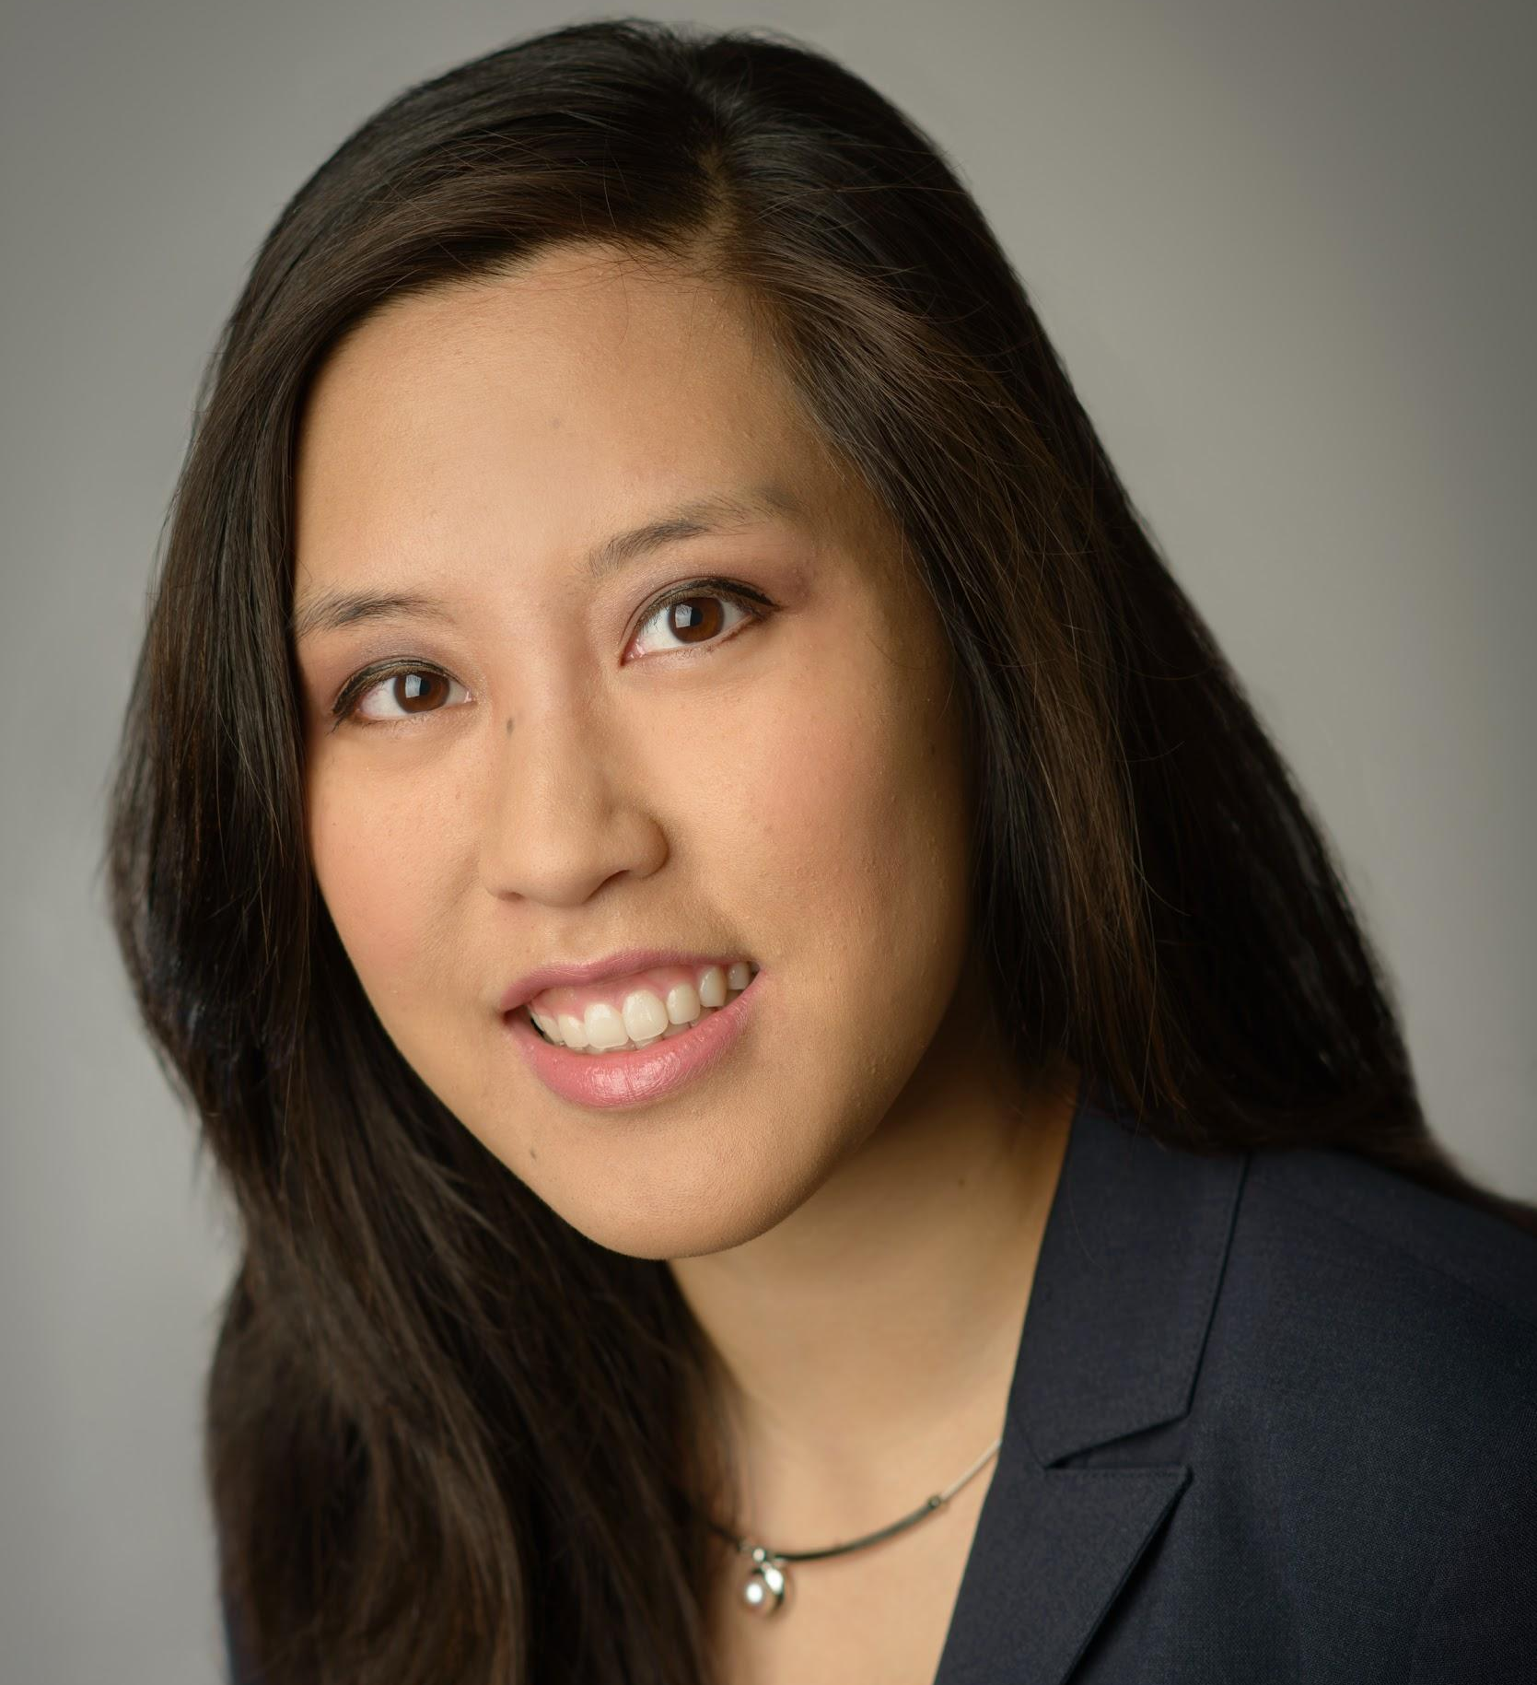
Alumni Relations
Amanda Young
Amanda.Young@stern.nyu.edu
Undergrad: University of Pennsylvania
Pre-Stern: Business Development
Summer Internship: Corporate Strategy at Prudential
Other Interests: Traveling, Hiking, Trying New Cuisines

Slide 20
AVP of Alumni
Relations (1)
Maintain open connection with Stern alumni network
Reach out to active members of the strategy and corporate finance community for “Alumni of the Week” section in the newsletter
Work with events VP to coordinate alumni happy hours and networking events

Slide 21
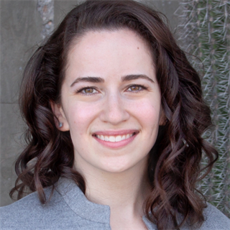
Admissions
Hannah Rose Schonwald
hrs381@stern.nyu.edu
Undergrad: Brown University
Pre-Stern: Center for Negative Carbon Emissions
Summer Internship: Corporate Finance at Pfizer
Other Interests: Being a cat mom

Slide 22
AVP of Admissions (1)
Field questions from incoming and prospective students
Participate in events such as Preview Weekend and class visits
Liaise with Admissions office

Slide 23
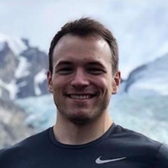
Communications
Alexandre Danis
Alexandre.Danis@stern.nyu.edu
Undergrad: Georgetown University SFS
Pre-Stern: PasionFutbol.com
Summer Internship: JPMorgan Chase PWM
Other Interests: SCUBA Diving, Race Car Driving, Spearfishing, Lifting

Slide 24
AVP of Communications (1)
Help VP manage distribution of newsletters and email communications through CampusGroups
Create marketing materials for event promotion
Manage social media platforms, website, tech needs of club
Operational support for events, panels, conferences
Maintain calendar of events, partner with VP of Corporate Relations and/or VP of Events to cross-promote career-related and/or alumni-related events, respectively
Responsible for the following deliverables: updating website, calendar of events (in conjunction with board)

Slide 25
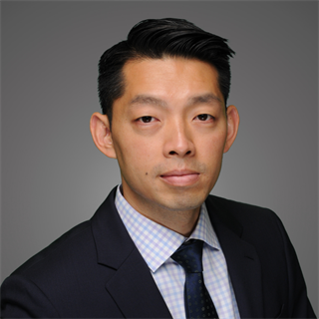
Finance
LeChun Wang
LeChun.Wang@stern.nyu.edu
Undergrad: University of Pittsburgh
Pre-Stern: US Army
Summer Internship: Corporate Finance at Pfizer
Other Interests: Lifting, Food

Slide 26
AVP of Finance (1)
Facilitate relationships between club and OSE, OCD & Admissions
Assist VP with club budgeting and reimbursement process
Manage finances and analyze profit and loss of each event / over the year period and any late payments
Supervise reimbursement of officers
Prepare financial reports and reconcile monthly budget
Provide quarterly reports to club membership
Forecast yearly budget

Slide 27
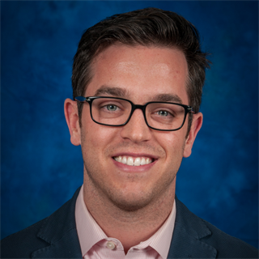

Langone
Bradley Shane
bcs392@stern.nyu.edu
Undergrad: Emory University
Current Job: Finance at PepsiCo
Other Interests: Hiking, CrossFit, Wine
Edward Hill
eh2463@stern.nyu.edu
Undergrad: Boston University
Current Job: VC Associate and Pure Energy Partners
Other Interests: Surfing, Marathons, Soccer

Slide 28
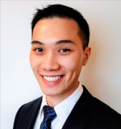
Langone
Michael Yuen
my719@stern.nyu.edu
Undergrad: NYU College of Arts and Science
Current Job: Morgan Stanley Wealth Management
Other Interests: Running, Traveling

Slide 29
AVP of Langone (2)
Advocate for Langone Program
Encourage all events to be recorded
Coordinate scheduling for club-wide events to accommodate Langone (& EMBA students when possible)
Idea generation on: conference preparation, job search strategy/ idea exchange sessions, interview preparation (with each other or alumni), mentoring program, Langone panels/ speaker series (live or via webinar), social events
Promote club events to Langone/ EMBA students
Promote/ link students and alumni to club video library and resources

Slide 30
Application Process
Thursday, September 5 - Kickoff Happy Hour
Friday, September 13 - AVP Applications Open
Tuesday, September 17 - AVP Applications Due
Wednesday, September 18 to Friday, September 20 - AVP Interviews
Friday, September 20 - Boards Finalized
* ALL OF THIS WILL BE EMAILED TO YOU BY SGOV *

Slide 31
Upcoming Events
Thursday, 9/5/2019 6:30PM-8:30PM @ The Half Pint
Club Kickoff Happy Hour
Thursday 9/19/2019 12PM-1:30PM @ Cantor Ballroom
"What is a Rotational Program?" Panel
Tuesday 9/24/2019 12PM-1:30PM @ KMC 1-70
"What is Corporate Finance?" Presentation
Wednesday 9/25/2019 8AM-9AM @ KMC 1-70
Strategy Summer Internships Panel
Thursday 10/3/2019 8AM-9AM @ KMC 1-70
Corporate Finance Internships Panel

Slide 32
Questions?
Sign-up through Campus Groups –
$30 Life-Time Membership Fee
Email: sms@stern.nyu.edu
Website
Join us on CampusGroups
Talk with us on Microsoft Teams

